Slide 1
Speed Jester
Aaron Monahan, Eduardo Souto, Filipe Caldas
Wild Mutants

Slide 2
Our Project
Project Introduction
Functional Requirements
Team Members and Responsibilities
Materials and Resources
Design Overview
Detailed Design

Slide 3
Speed Jester
Objectives
Create an application that tests download/upload speeds on your network
Display results in a GUI

Slide 4
Functional Requirements
Allow a user to input the server IP address and port number.
The user shall be prompted to start the program to test download/upload speed.
While the tests are running, the program will display live updates on transfer rate.
The program shall display error messages to the user in case of failure.
Test duration 20 seconds each (upload/download).
The user shall be able to stop the program at any time during the test.
After the program times out or the user stops the program, it will display the final data transfer speed in Kbps/Mbps/Gbps.

Slide 5
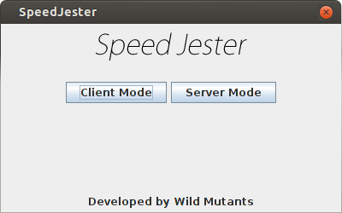
Team Members
Aaron - Data source layer
Eduardo - Data source layer
Filipe - Presentation layer

Slide 6


Materials and Resources
Java
JFrame
Github

Slide 7
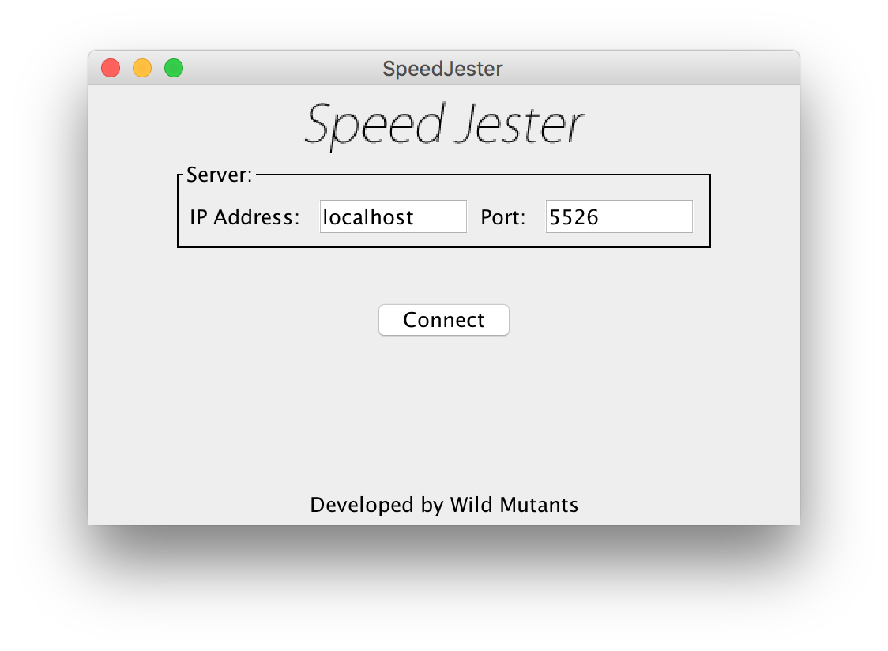
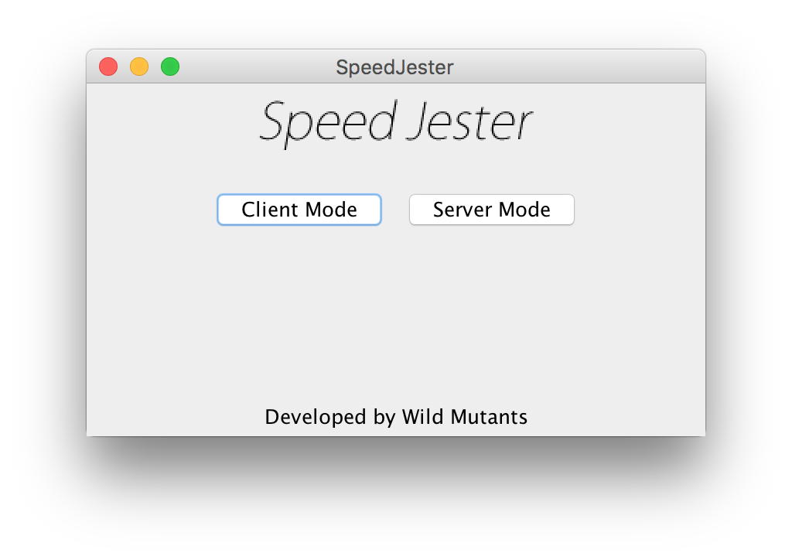
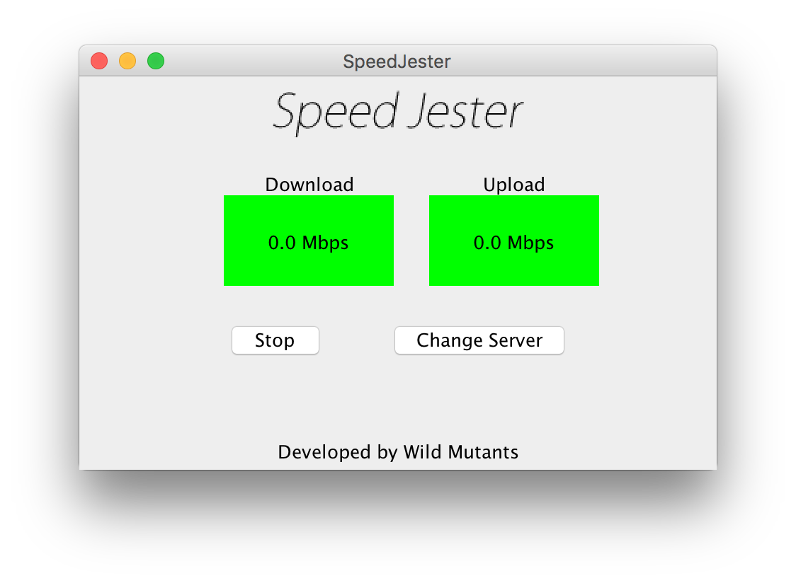
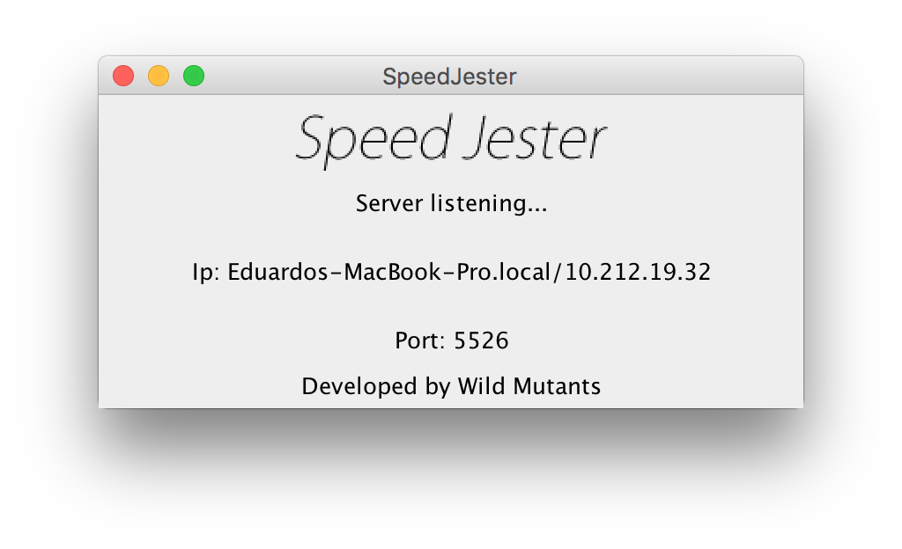
Interface
Client
Server

Slide 8
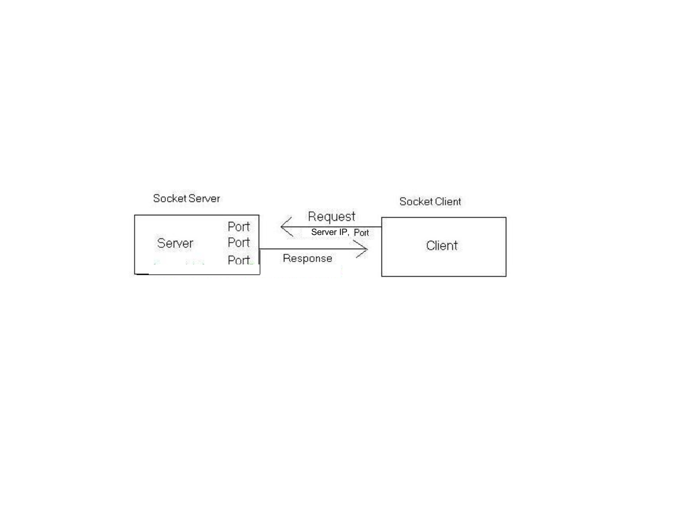
Design Overview
Connection is created
Data is sent from server and received by client
Data is sent from Client to Server
Speeds are recorded
Client-Server connection used in Speed Jester

Slide 9
Detailed Design
Connection is created
public void openConnection()
{
socket = new Socket(host, port);
dataIn = new BufferedReader(new InputStreamReader(socket.getInputStream()));
dataOut = new PrintWriter(socket.getOutputStream(), true);
}

Slide 10
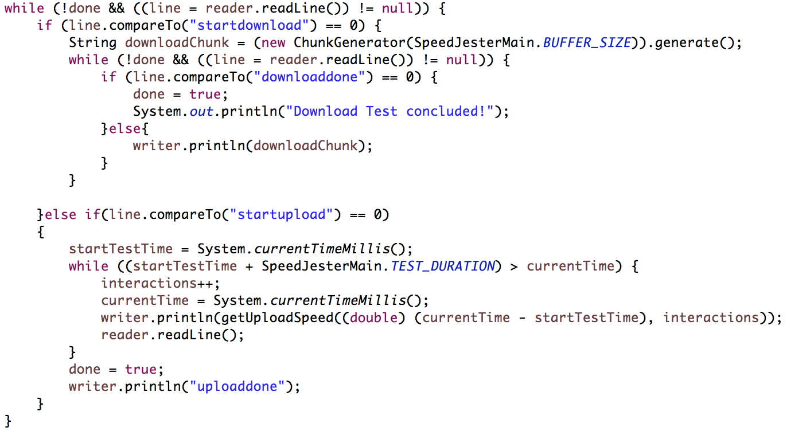
Server Code

Slide 11
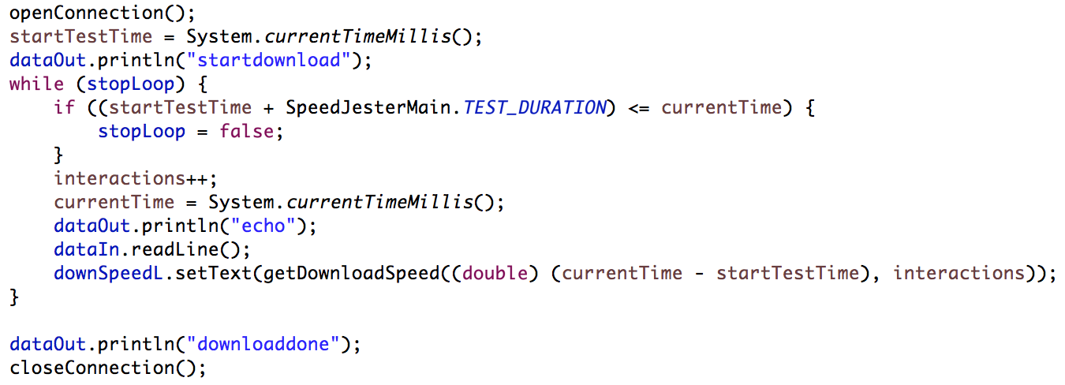
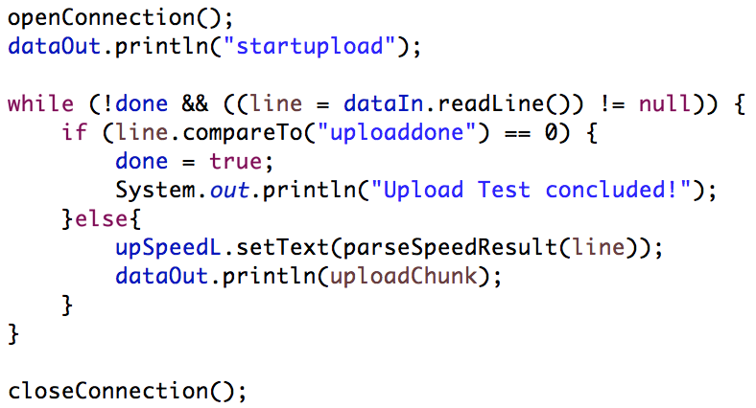
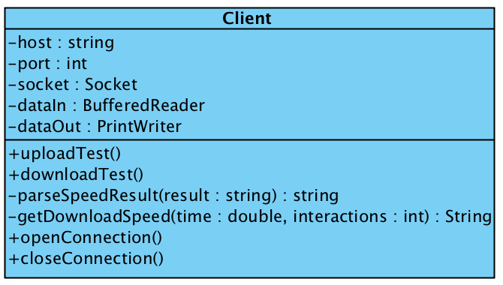
Download
Client Code
Upload

Slide 12
Conclusion
Creating this application gave us more exposure to computer networks by interacting with sockets and data transactions. Working with sockets taught us how other applications could interact with remote servers by sending and receiving data.
We experienced how physical media affected network connection transmission rate such as wireless v.s. wired connections.

Slide 13
Live Demonstration

